Slide 1

DAT-NYC-43: Unit Project 4
John Hanlon

Slide 2
Executive Summary
Aim and Goals
Datasets
Methods, Models, and Analysis
Risks and Assumptions
Conclusion

Slide 3
Aim and Goals
The goal of this exercise was to analyze a dataset of admitted and rejected applicants to a graduate institution
We first perform exploratory data analysis (EDA) to understand the dynamics and descriptive statistics of the dataset
We then hypothesize that the both undergraduate prestige and gpa will correlate positively with admission into the graduate program
Additionally, we hypothesize that prestige and gpa will have a stronger effect size for the students who graduated from a higher prestige school than a lower prestige school

Slide 4
Executive Summary
Aim and Goals
Datasets
Methods, Models, and Analysis
Risks and Assumptions
Conclusion

Slide 5
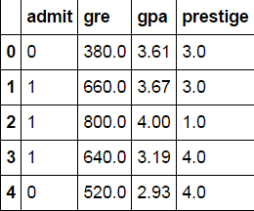
Datasets
The dataset provided was a list of 400 students applying to the graduate program of an educational institution
The dataset had four variables:
admit: Answers if the student admitted to the program (1=Yes, 0=No)
gre: The GRE score of the applicants (ranging from 220.00 to 800.00)
gpa: The GPA score of the applicants (ranging from 2.26 to 4.00)
rank: The prestige of the student’s previous education (ranging from 1 to 4, with 1 coded as the most prestigious)
This was later adjusted to read ‘prestige’ to account for Python’s prepackaged ‘Rank’ function

Slide 6
Executive Summary
Aim and Goals
Datasets
Methods, Models, and Analysis
Risks and Assumptions
Conclusion

Slide 7
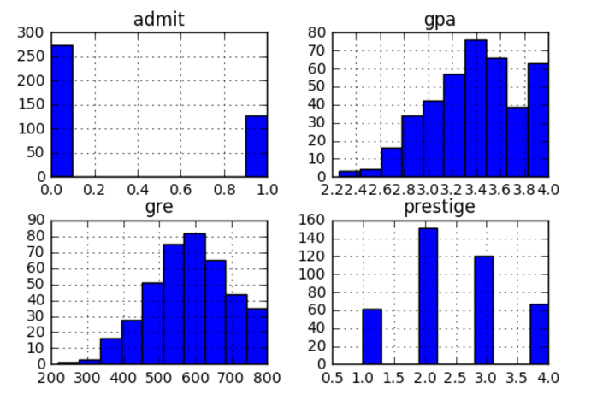
Methods, Models, and Analysis
An analysis of the each variable plotted as a histogram shows that the school maintains a 31% acceptance rate
The visual representation helps to formulate our hypothesis that the gpa and prestige are positively correlated with ‘admit’
Additionally, those who attended a more prestigious university will have a higher probability of gaining acceptance than their peers at a school coded with less prestigious, even if they earned the same GPA

Slide 8
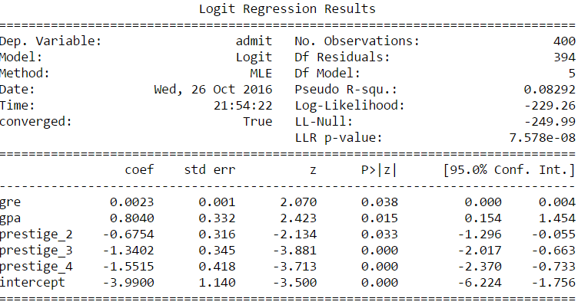
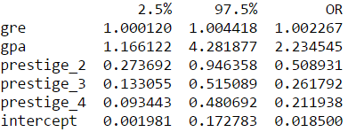
Methods, Models, and Analysis
The p-values resulting from our logistic regression show that we can reject the null-hypothesis
The additional table, ‘Odds Ratio (OR) and 95% Confidence Interval’, shows that admission is more likely when:
i.) An applicant has a higher GPA (2.23x)
ii.) An applicant attended a more prestigious school (Prestige 2 0.51x likely vs. Prestige 1)
Odds Ratio (OR) and 95% Confidence Interval

Slide 9
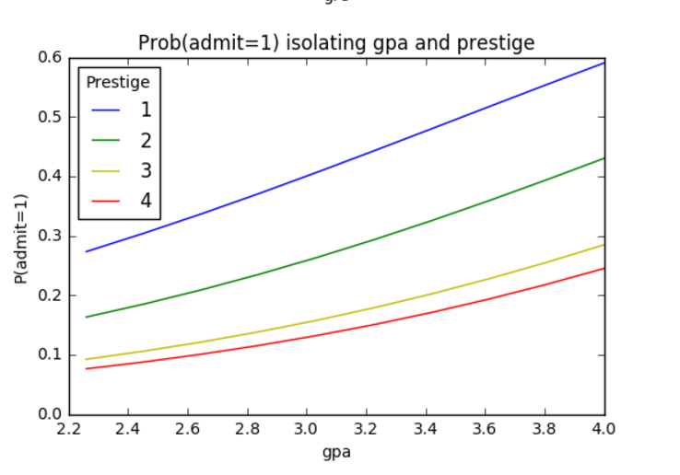
Methods, Models, and Analysis
Finally, we compare the effect size of an applicant’s GPA and undergraduate school’s prestige on graduate school admission
The associated visual shows that applicants with higher GPAs are more likely to gain admission
Additionally, when holding GPAs constant, applicants attending more prestigious undergraduates are more likely to gain admission than their peers attending less prestigious schools
Odds Ratio (OR) and 95% Confidence Interval

Slide 10
Executive Summary
Aim and Goals
Datasets
Methods, Models, and Analysis
Risks and Assumptions
Conclusion

Slide 11
Risks and Assumptions
Minimal background of data provided
We do not know how this data was obtained or selected
Without context we cannot confidently interpret the results with any relevant significance
For example, any inferences resulting from the analysis of a 1950s dataset would most likely not be representative of a current dataset
Data was not normally distributed
The analysis of the dataset via panda’s skew and kurt modules showed that the dataset was not normally distributed – we did not run a linear regression, however it should be noted
df[i].skew() != 0
df[i].kurt() != 0

Slide 12
Executive Summary
Aim and Goals
Datasets
Methods, Models, and Analysis
Risks and Assumptions
Conclusion

Slide 13
Conclusion
We were able to reject our null-hypothesis and say that that the ‘gre’, ‘gpa’, and ‘rank’ (later broken down into ‘prestige_#’ dummy variables) have an effect on the ‘admit’ variable
Additionally, an analysis of the odds ratios and confidence intervals confirm there is a relationship between the above variables and an applicant’s admission
Furthermore, charting the logistic regression shows how applicants with higher GPAs are more like to gain admission to graduate school
When keeping GPA constant, we see that the prestige of the applicant’s undergraduate school is highly predictive as well

